Slide 1
Intro to Reliability
30 August 2020

Slide 2
Reliability Definition
Is the probability an item (e.g., system, subsystem, or component) will perform its intended function with no failure for a stated period of time (or number of demands or load) under stated environmental conditions. Other words, reliability is the probability an item will be in an uptime state (i.e., fully operational or ready to perform) for a stated mission.

Slide 3
Reliability Break Down
RELIABILITY
The Probability
(used to make 1 of the 2 axes of a risk matrix)
An item will perform its intended function
For a stated mission time (duration as time or cycles) or stress (load)
Under stated conditions (environment).
Qualitative Reliability
Quantitative Reliability
Multiple components mapped to form a system
Perform a bottom-up analysis to show the effect(s) of the item’s failure
Perform a top-down analysis to show how item(s) contribute to a specific failure event
Make and use a custom failure-rate function using item’s test and operational data
Use handbooks to obtain constant failure rates (adjusted for various conditions)
Reliability Block Diagram Analysis (RBDA)
Failure Mode and Effects Analysis (FMEA)
Fault Tree Analysis (FTA)
Demonstrated Reliability
Predicted Reliability

Slide 4
Reliability as a Function within SWPC
To learn
To improve
To resolve

Slide 5
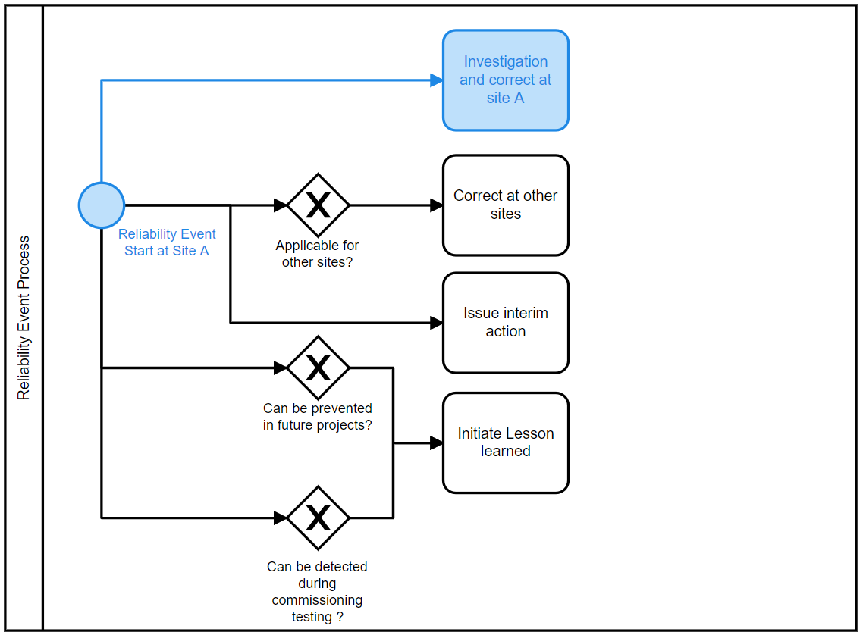
Reliability as a Function within SWPC

Slide 6
Why

Slide 7
Safety
We often hear,
“Reliable Plant is a Safe Plant”
But how is that ?
How can this effect the personals and the plant ?
Can we do something about it ?

Slide 8


Safety
SLIPS/TRIPS
MANY
INJURY BUT NOT DEADLY
3X DURINNG NON PLANNED
Safety
PROCESS SAFETY
FEW
DEADLY
PROBABILITY INCREASE WHEN RELIABILITY DECREASSE

Slide 9
Safety
EXAMPLES…

Slide 10
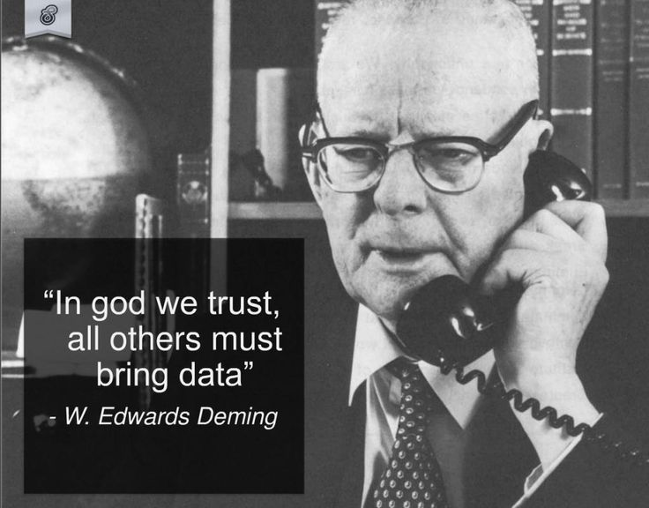
safety

Slide 11
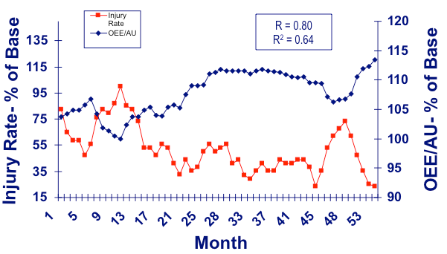
Personal Safety
Personal Safety.
There is a negative correlation between reliability and injures rate.

Slide 12
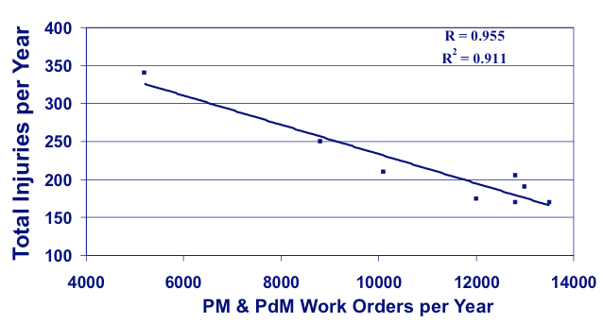
Personal Safety
Personal Safety.
There is a negative correlation between reliability and injures rate.

Slide 13
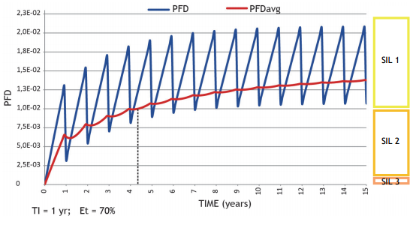
Process Safety
Process Safety.
The figure below show how the Probability of Failure on Demand (PFD) increase with time.
Once the proof test conducted; the reliability is restored.

Slide 14
Process Safety
Process Safety.
The figure below show how the Probability of Failure on Demand (PFD) increase with time.
Once the proof test conducted; the reliability is restored.
Similar to the proof testing tasks:-
Condition monitoring
Inspection
Calibration
PMs jobs.
Proof testing
Reliability Decrease
when PFD Increase

Slide 15
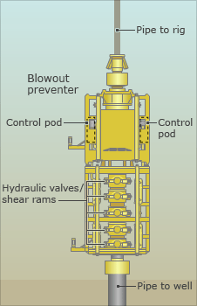
Case Study: Deep Water Horizon
On April 20, 2010
11 killed and 17 Injured
Due to the failure of the Safety Instrumented System (SIS).
This failure was linked to inability to perform functional test.
The design of the BOP control system did not allow independent functional testing of its redundant AMF/deadman subsystems either while the BOP was on the rig or while it was in subsea service. There were four separate emergency subsystems which could activate the AMF/deadman; there were two control pods, each with its own 27 volt battery pack, and each of these two pods had two independent subsea electronics modules (SEMs), each with its own programmable logic controller (PLC), AMF/deadman card and 9 volt battery pack. However, the four subsystems could not be independently tested using the BOP control system. Without independent functional testing for each of these four subsystems, latent failures which disable as many as three of these redundant systems could still result in a successful overall AMF/deadman test result. A successful test even with no working redundant backups would fail to reveal that the reliability of the AMF/deadman emergency safety was severely compromised. *

Slide 16
Deep Water Horizon
Video

Slide 17
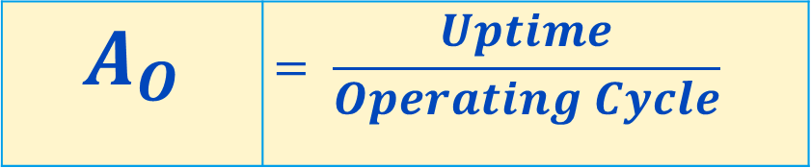
Availability
AVILABILITY is % of time where the equipment is available for use.
To calculate it we need 2 things:-
Operating Cycle (Time between TAs)
Up Time (time the equipment were running)
$$A_{O}$$ | $$= \frac{Uptime}{Operating Cycle}$$

Slide 18
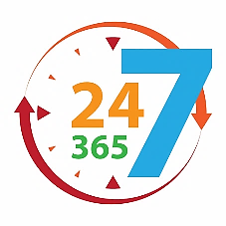
Availability
$
=

Slide 19
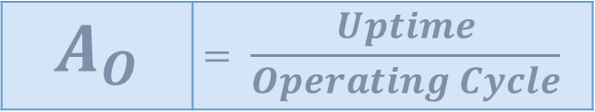
Availability Example
Operating cycle = 8 hours daily for 1 week = 8 x 7 = 56 hours.
1 pump
12 Ton per/H, 1Ton = 100 SAR
1 failure per 16 hours.
To fix it we need 2 hours.
$$A_{O}$$ | $$= \frac{Uptime}{Operating Cycle}$$

Slide 20
Availability Example
16 Hrs.
Failure
Failure
1
0
Maintenance
Maintenance
2 Hrs.
Time
56

Slide 21
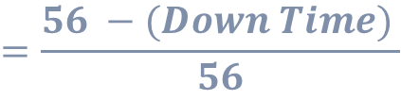

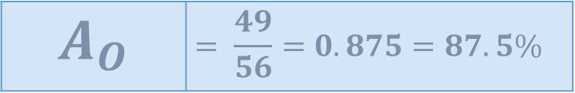

Availability Example
16 Hrs.
Failure
Failure
1
0
Maintenance
Maintenance
2 Hrs.
Time
56
$$A_{O}$$ | $$= \frac{Uptime}{Operating Cycle}$$
$$=\frac{56 −(Down Time) }{56}$$
$$=\frac{56 −(3.5 X 2) }{56}$$
$$A_{O}$$ | $$= \frac{49}{56}=0.875=87.5\%$$

Slide 22


Availability Components
Less Failure,
Less Maintenance Time
Result High Availability
= +
AVILABILITY RELIABILITY MAINTEANBILITY

Slide 23




Availability Components
Result
AVIALABILITY
SAFETY
What we Can Improve
RELIABILITY
MAINTENABILITY
Design
Condition monitoring
Inspection
Calibration
PMs jobs.
Proof testing
Precision.
Design
Procedures
Planning
TPM
Automation
Move CM to PM/Pdm

Slide 24
Root Cause Analysis

Slide 25
Investigation cycle
Experience
Generalization
Observe
Action
Analyze
Decision
Insight
Conclusion

Slide 26
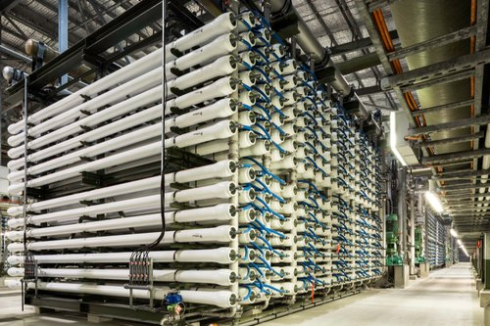
Problem Statement
On 5th/March/2019 at 22:00 hrs. in plant x RO shelter 6 Racks tripped for 12 hours and resulted in losing 200,000 m3 of water.
WHEN
WHERE
PROBLEM STATEMENT
WHAT
EFFECT

Slide 27
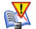


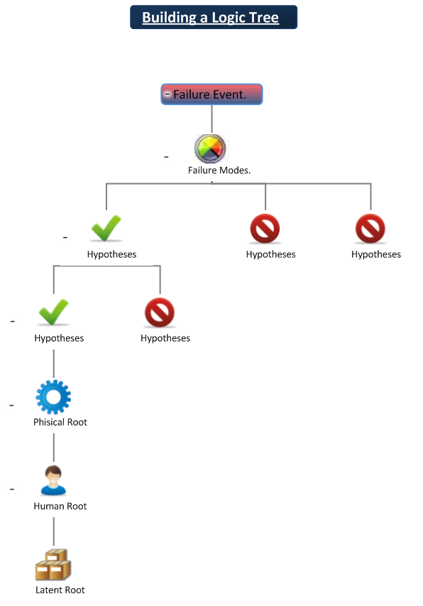



Logic Tree
1. Describe the Event
Fact Line
2. Describe the Modes
How Could?
3. Hypothesize
Fact Line
.
4. Verify the Hypotheses
Fact Line
How Could?
5. Determine Physical Roots
and Verify
.
Fact Line
6. Determine Human Roots
and Verify
.
How Could?
Fact Line
Why ?
7. Determine Latent Roots
.
.

Slide 28
System life cycle

Slide 29

System Reliability
A CHAIN IS ONLY AS STRONG AS ITS WEAKEST LINK

Slide 30

Example
Tensile
Stress
50 N/m²
LINK
TENSILE STRENGHT N/m² | 60 | 70 | 55 | 45 | 30
Which link will break ?

Slide 31
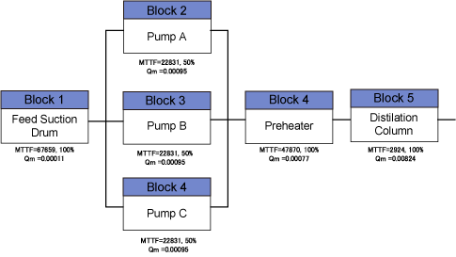
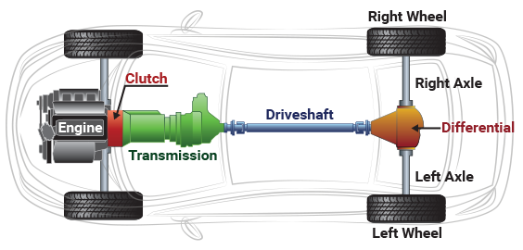
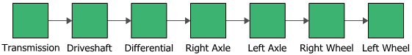
System Reliability

Slide 32
Life Cycle

Slide 33



Bathtub Curve
PROBABILITY OF FAILURE
Design
Derating
Installation
No experience
Testing
Standards
Procedure
Training
Warranty Management
TIME

Slide 34
Bathtub Curve
PROBABILITY OF FAILURE
Out of operating window
Wrong maintenance
Strictly following the procedures.
CMs
TIME

Slide 35
Bathtub Curve
Aging like everything
PMs
CMs
Generally taking care of the old assets.
TIME

Slide 36
Mobile Exercise

Slide 37
Thank you

